Slide 1


FED TAPERING
UNDERWRITING

Slide 2

Understanding
“Underwriting”

Slide 3

UNDERWRITING
Rakesh, a music lover was aware that the students of the city were dying to see the Rock Band, “Spark” perform in Mumbai.
So he approached his friend, Rohit, a seasoned businessman with the idea of hosting such an event. Rohit also felt that the idea was good and thought he could make a killing out of this.Q

Slide 4
UNDERWRITING
He decided to market the event. When he realized that the cost of marketing such an event was huge, he started getting cold feet.
He started to think, “What if he did not get a full house? What if it started raining on the day of the event?” He knew that only a packed house would become “news” that would help his reputation.

Slide 5
UNDERWRITING
Sensing that indecisiveness was finding its way into Rohit's mind, Rakesh went on an overdrive to ensure that Rohit does not back out. Rakesh was convinced about the success of the idea.
He walked up to Rohit and proposed that he would buy the unsold tickets, if there would be any.

Slide 6
UNDERWRITING
That assurance was good enough for Rohit to make his decision to go all out and invest the money in creating and marketing the event.
This assurance of purchasing the unsold tickets is similar to what is popularly known as “Underwriting”.

Slide 7
UNDERWRITING
In underwriting, in this context, a company is trying to raise money from the market by issuing shares. The underwriter is the person who helps the promoter in marketing the issue so that it either gets oversubscribed or 100% subscribed.
In case of a shortfall, the underwriter purchases the outstanding shares.

Slide 8
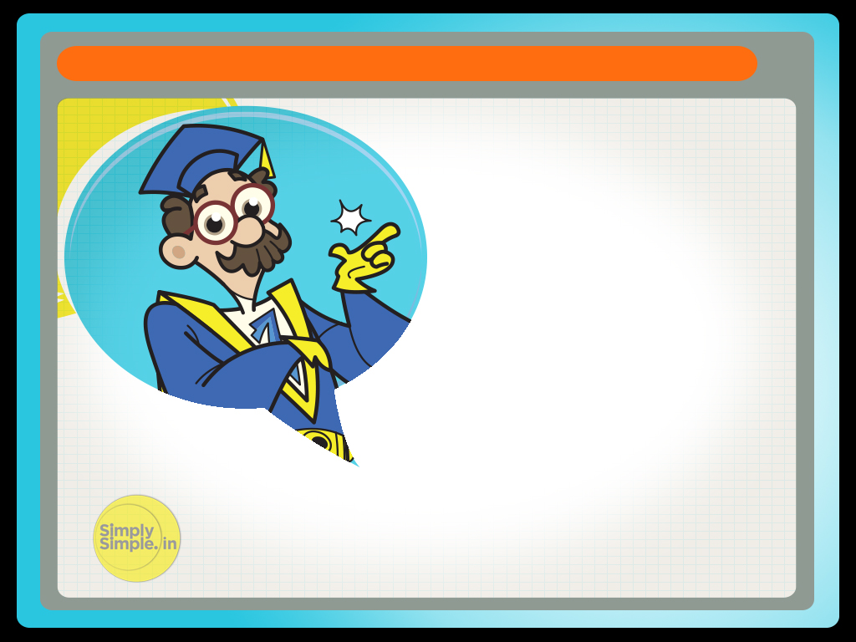
UNDERWRITING
Hope this lesson has helped you in understanding the term Underwriting

Slide 9
Please give us your feedback at
professor@tataamc.com

Slide 10

DISCLAIMER
The views expressed in this lesson are for information purposes only and do not construe to be any investment, legal or taxation advice. The lesson is a conceptual representation and may not include several nuances that are associated and vital. The purpose of this lesson is to clarify the basics of the concept so that readers at large can relate and thereby take more interest in the product / concept. In a nutshell, Professor Simply Simple lessons should be seen from the perspective of it being a primer on financial concepts. The contents are topical in nature and held true at the time of creation of the lesson. This is not indicative of future market trends, nor is Tata Asset Management Ltd. attempting to predict the same. Reprinting any part of this material will be at your own risk. Tata Asset Management Ltd. will not be liable for the consequences of such action.
Mutual Fund investments are subject to market risks,
read all scheme related documents carefully.

